Slide 2
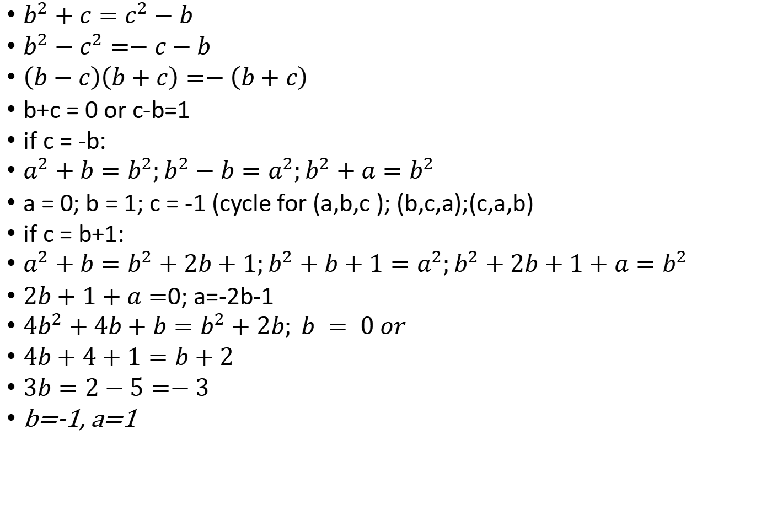
$$a^{2}+b=c^{2};b^{2}+c=a^{2};c^{2}+a=b^{2};$$
$b^{2}+c=c^{2}−b$
$b^{2}−c^{2}=−c−b$
$\left(b−c\right)\left(b+c\right)=−\left(b+c\right)$
b+c = 0 or c-b=1
if c = -b:
$a^{2}+b=b^{2};b^{2}−b=a^{2};b^{2}+a=b^{2}$
a = 0; b = 1; c = -1 (cycle for (a,b,c ); (b,c,a);(c,a,b)
if c = b+1:
$a^{2}+b=b^{2}+2b+1;b^{2}+b+1=a^{2};b^{2}+2b+1+a=b^{2}$
$2b+1+a=$0; a=-2b-1
$4b^{2}+4b+b=b^{2}+2b; b = 0 or$
$4b+4+1=b+2$
$3b=2−5=−3$
b=-1, a=1

